Slide 1
Thesis Proposal The use of artificial neural networks for phytoplankton species identification
David Vasquez
IST 512

Slide 2
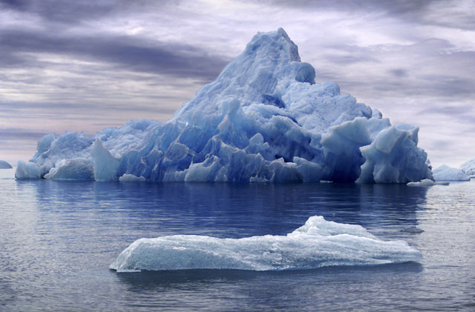
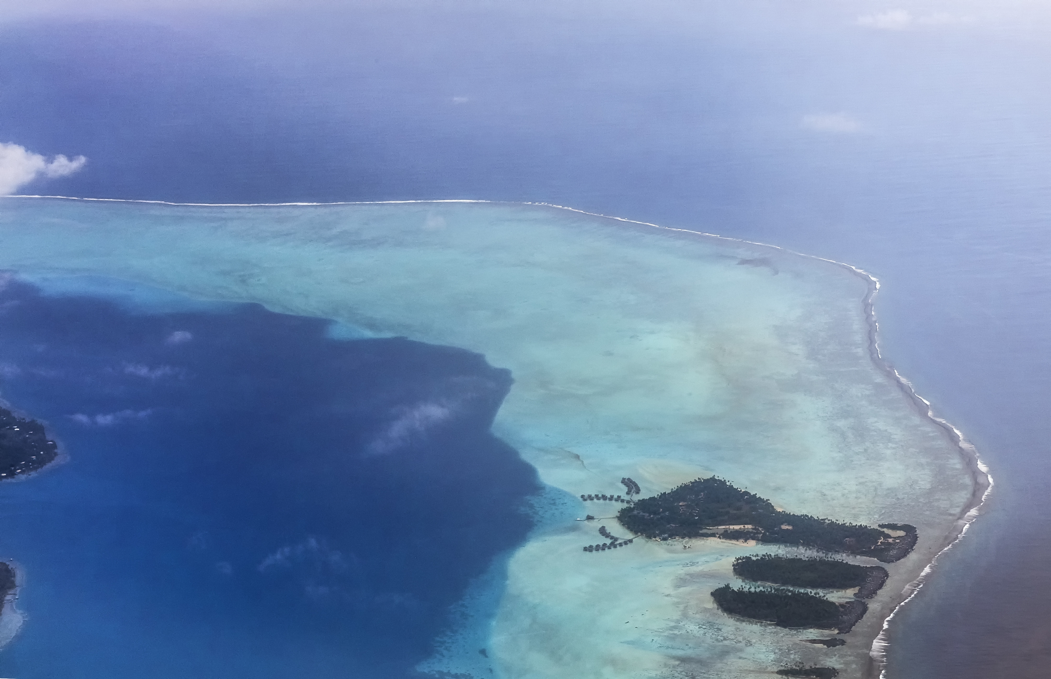
Literature Review: Phytoplankton
Small but Important!
Diverse and everywhere (almost)
Indicator of Climate Change

Slide 3
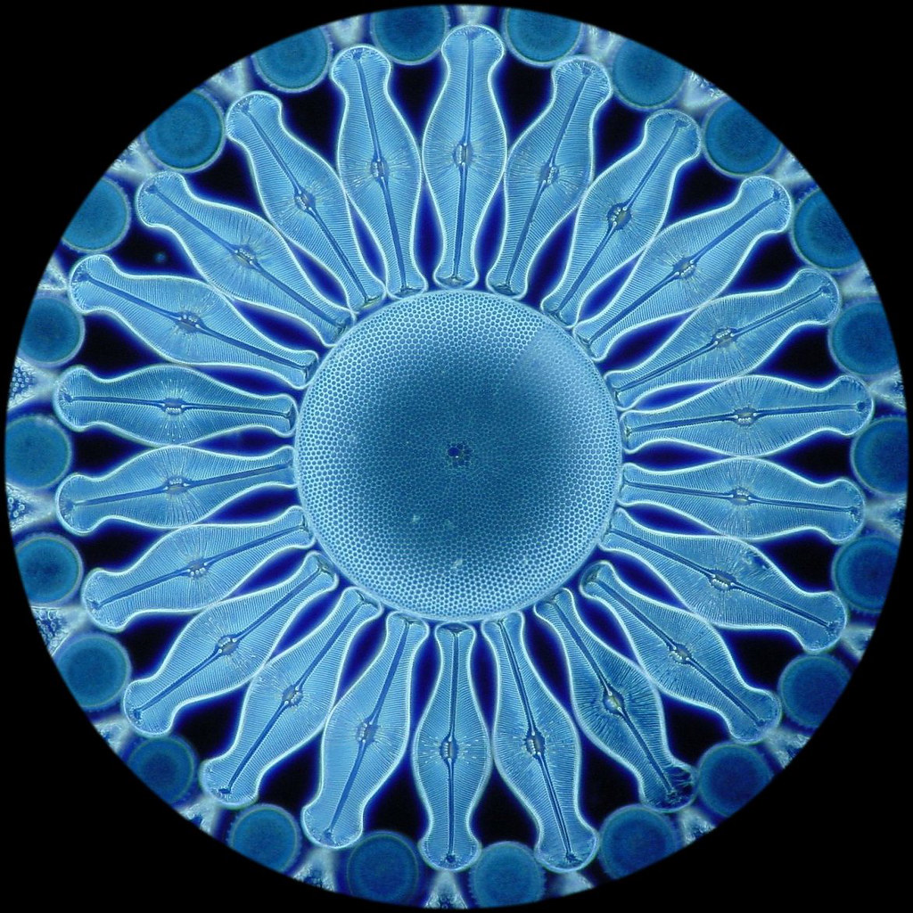
Literature Review: Phytoplankton
Composition (Redfield Ratio)
Photoautotrophic
Carbon Fixers
Primary Producer in the Euphotic Zone
A photomicrograph of an oceanic diatom, which can turn dissolved phosphorous into an inorganic mineral shell.

Slide 4
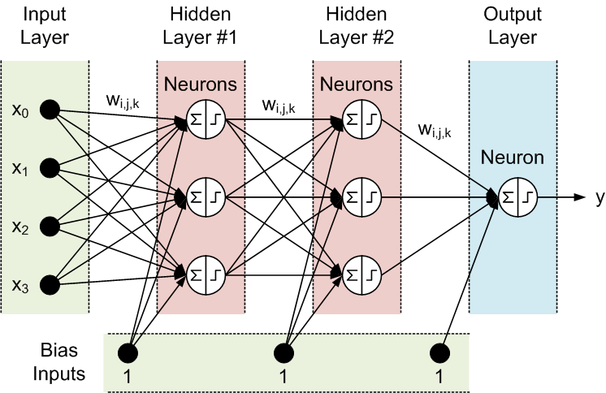
Literature Review: Machine Learning and Neural Networks
A computational method to learn from data patterns
Makes use of patterns similar to actual neural networks
Supervised Learning
What I will use
Unsupervised Learning

Slide 5
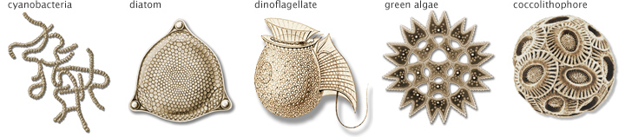
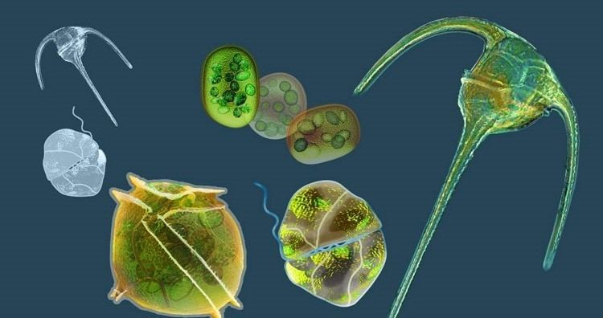
Methodology: Phytoplankton Cultures
Three sets of phytoplankton data will be collected that contains 50 species of phytoplankton
Data will cover a range of size and morphological shapes

Slide 6
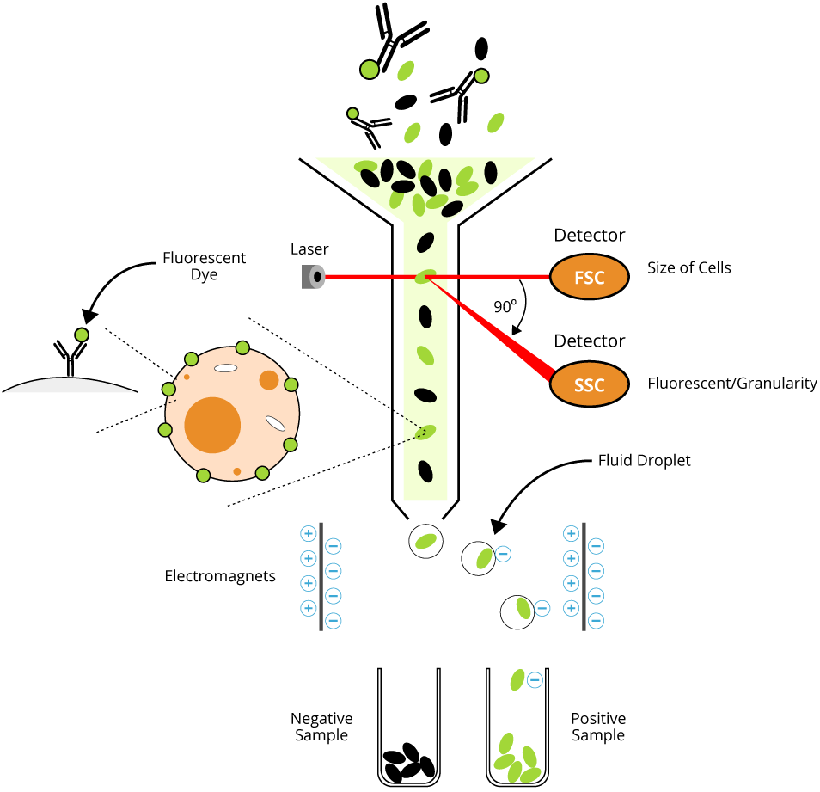
Methodology: Flow Cytometry
A way to sort and classify cells

Slide 7
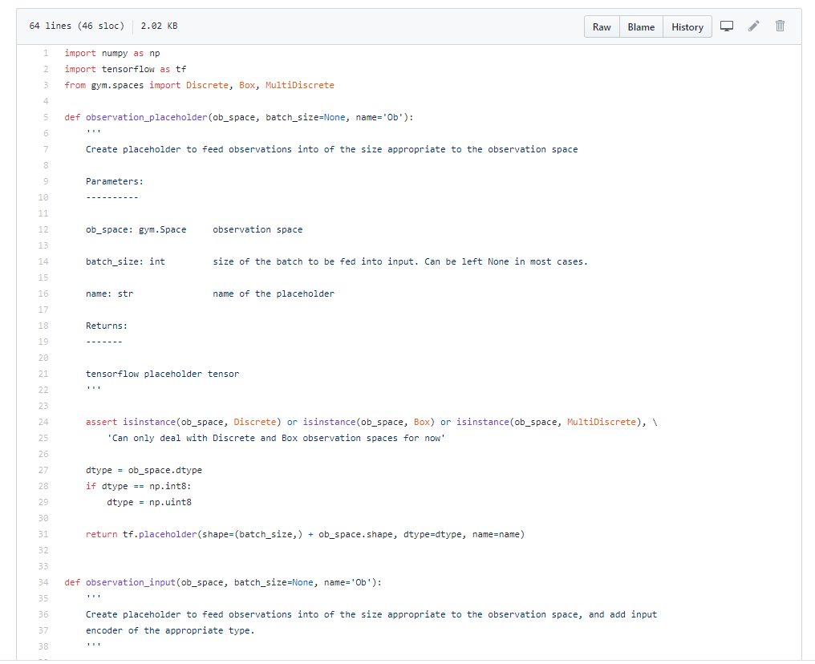
Methodology: Machine Learning and Computational Methodology
Python
AWS Linux Servers
Functions, Classes and Functional Programming

Slide 8
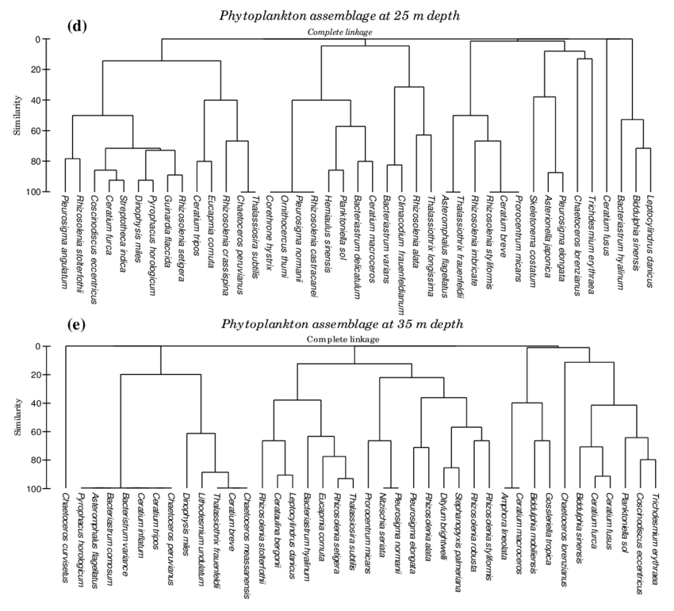
Analysis: Hopeful Results
Statistically useful outcomes
Development of a Dendogram
Scalable to other Research

Slide 9
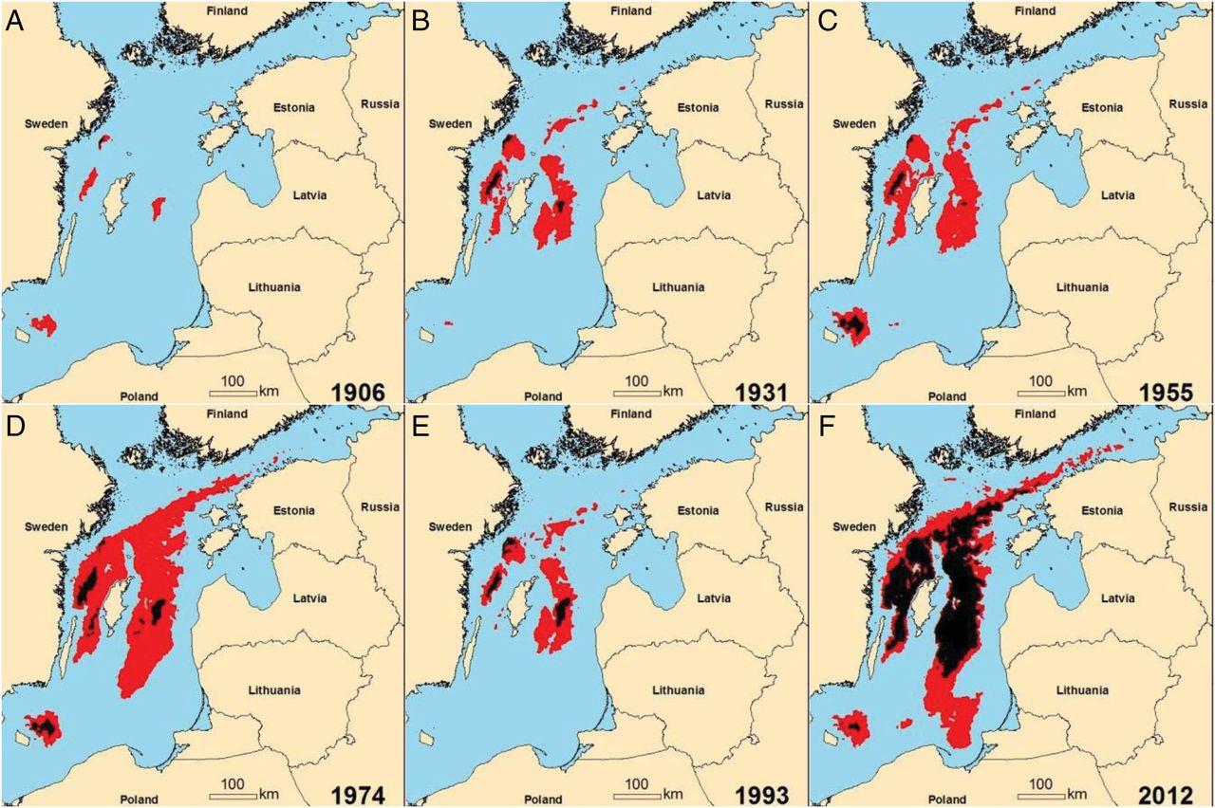
Analysis: Utilizing Scientific Data
RESTful API with JSON output
Still running on AWS
Developing algorithms to span past research and bring it into future research
Past research in the Baltic Sea looking at Hypoxia

Slide 10
Conclusion
Hopefully will be useful
There will be a lot of hurdles
Data Gathering
Data Analysis
Algorithm Development

